Slide 1
UML Diagrams:
The Static Model
Class Diagrams

Slide 2
The Static Model
Define the static structure of the logical model
Represent classes, class hierarchies using packages and their relationships,
Evolve in three phases the conceptual phase, the analysis phase, and the design phase.

Slide 3
The conceptual Level
At the conceptual phase, classes are defined based on the classes found in the problem domain descriptions,
A context class diagram is defined first, where the system under development is represented by one package and external classes representing the actors

Slide 4
Context Class Diagram
<<external>>
Input Devices
<<external>>
Output
Devices
System under
development

Slide 5
The conceptual Level
The system package is defined by a diagram representing the main subsystems and interface classes to external classes
Each subsystem is represented by a class diagram defining the classes of objects needed to realize the use cases define in the use case diagrams

Slide 6
The conceptual Level
<<Interface>>
Input_devices
Monitors
Controllers
<<Interface>>
Output_devices

Slide 7
The Analysis Level
At the analysis level, subsystem class diagrams are refined by adding attributes and methods depicting how objects of the static view are used to realize use cases in sequence diagrams
Emphasis is placed on distributing behavior, resolving software interfaces, and identifying generalization relationships that will maximize the effectiveness of the object model

Slide 8
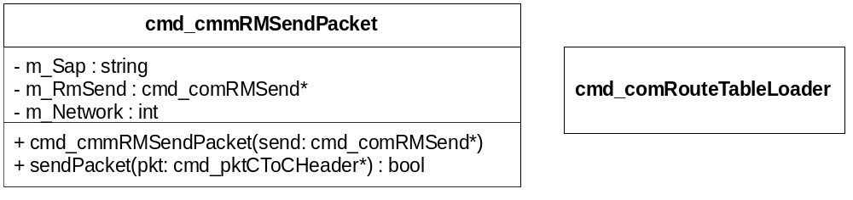
The Class Diagram Notation
Classes, their attributes and methods are specified based on the objects needed to realized use case and interfaces to external entities

Slide 9
Class relationships
Parent
Association
Aggregation/Composition
Generalization

Slide 10
Associations Between Classes
Associations between classes are generally shown as solid lines connecting the associated classes.
A notable exceptions to the solid line rule are the use of dashed lines to depict dependencies as special case of association,

Slide 11
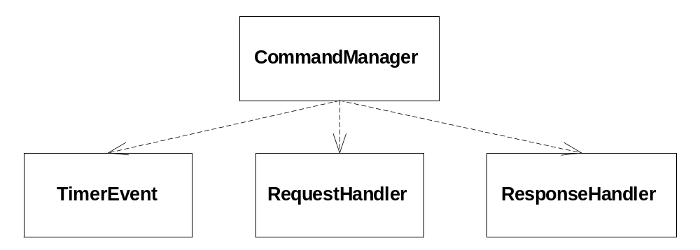
Dependency: A Special Case of Association
Dependency
Client
CommandManager (Client class) depends on services
provided by the other three server classes

Slide 12
Aggregation Relation
Aggregation – A hollow diamond is attached to the end of the path to indicate aggregation. The diamond is attached to the class that is the aggregate. Aggregation provides a definitive conceptual whole part relationship

Slide 13
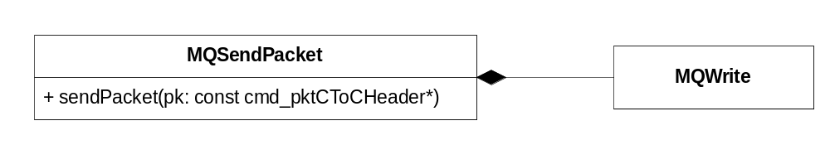
Composition: A Special Case of Aggregation
Composition is shown as a solid filled diamond, with the diamond attached to the class that is the composite. Composition is a form of aggregation that requires coincident lifetime of the part with the whole and singular ownership; i.e. the part is owned by only one whole and is deleted when the whole is deleted

Slide 14
Generalization/Specialization Relation
Generalization is shown as a solid-line arrow from the child (the more specific element) to the parent (the more general elementthis type of relationship is also called inheritance.
Should be used to define class hierarchies based on abstraction

Slide 15
Generalization/Specialization Relation
Controllers and Monitors are examples of abstract classes
Controller
Brake Controller
Engine Controller

